Slide 1
photo booth rental in Culver City
https://www.luckyfrogphotos.com/culvercityphotobooth.html
Notes:
https://www.luckyfrogphotos.com/culvercityphotobooth.html
https://drive.google.com/drive/folders/1I6R9-rYT0dGtkdSSy_KoznKsqANOl7vo?usp=sharing
https://news.google.com/rss/search?q=videobooth
https://drive.google.com/drive/folders/1fz3MRTHqumYW9T_yhq1sJNXEaAI-SV1p?usp=sharing
https://drive.google.com/drive/folders/19E3a0DxL9zoXjvwMzIuZp1t-Y7DpGITl?usp=sharing
https://drive.google.com/drive/folders/1YdJqhK5hH37CRHupORSbvk9wfbtfe5a3?usp=sharing
https://drive.google.com/drive/folders/1yq_rvIpjf9fM7tolY6arXn-zbxeYDJVS?usp=sharing
https://drive.google.com/file/d/1t33hvFbsi4sSFSNdR8g74m5ACVKQUi0g/view?usp=sharing
https://drive.google.com/file/d/1zOl_0XNcTy6PryQuzm9JOEunbIaWwi8Z/view?usp=sharing
https://docs.google.com/spreadsheets/d/1OVT5yraxS5wjWLc6k7sw89mEC_b1-0gBgUpnB3NT2IA/edit?usp=sharing
https://docs.google.com/spreadsheet/pub?key=1OVT5yraxS5wjWLc6k7sw89mEC_b1-0gBgUpnB3NT2IA
https://docs.google.com/spreadsheets/d/1OVT5yraxS5wjWLc6k7sw89mEC_b1-0gBgUpnB3NT2IA/pubhtml
https://docs.google.com/spreadsheets/d/1OVT5yraxS5wjWLc6k7sw89mEC_b1-0gBgUpnB3NT2IA/pub
https://docs.google.com/spreadsheets/d/1OVT5yraxS5wjWLc6k7sw89mEC_b1-0gBgUpnB3NT2IA/view
https://docs.google.com/forms/d/16B2HxuSeFbeXYinSv_AilgUvJf4qxj78DgP7lfIc6p0/edit?usp=sharing
https://docs.google.com/drawings/d/1iFVgJRf2VdbzqoWwdN1jPBoTL09CZXeGnhHoTIs_qgw/edit?usp=sharing
https://drive.google.com/file/d/1Ub_baxN1yIKa7z6PHbWKiQ5Hv3QmkYdb/view?usp=drivesdk
https://sites.google.com/view/culvercityphotoboothrentals/home
https://docs.google.com/document/d/1kL-FctTx5XoCFD61RSPQO7RJ9h6wzXbRa-pCid0ppDY/edit?usp=sharing
https://docs.google.com/document/d/1kL-FctTx5XoCFD61RSPQO7RJ9h6wzXbRa-pCid0ppDY/pub
https://docs.google.com/document/d/1kL-FctTx5XoCFD61RSPQO7RJ9h6wzXbRa-pCid0ppDY/view
https://docs.google.com/presentation/d/1Y9vC6BNYbxHj5DnqzJHdpFd3jgOH6z_a3h9cJ0d7ILs/edit?usp=sharing
https://docs.google.com/presentation/d/1Y9vC6BNYbxHj5DnqzJHdpFd3jgOH6z_a3h9cJ0d7ILs/pub?start=true&loop=true&delayms=3000
https://docs.google.com/presentation/d/1Y9vC6BNYbxHj5DnqzJHdpFd3jgOH6z_a3h9cJ0d7ILs/view
https://docs.google.com/presentation/d/1Y9vC6BNYbxHj5DnqzJHdpFd3jgOH6z_a3h9cJ0d7ILs/htmlpresent

Slide 2
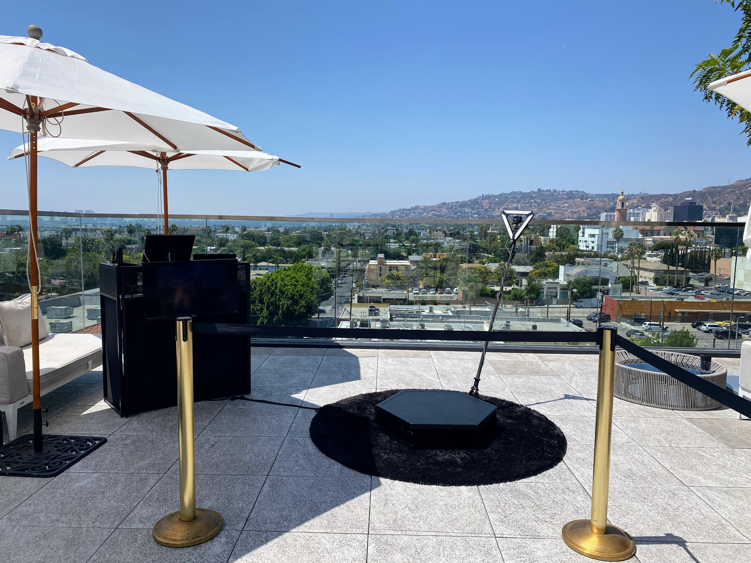

Slide 4
photo booth rental in Culver City
Just similar to Dining out, not every 360 video booth rentals near San Gabriel are similar. taking into account our best quality photo booth services, we hand crafted the best atmosphere spinner platform and slow pursuit video gear to create distinct your slomo Videos are the best in al of San Gabriel and the 626 area. Our read air Photo Booths, Selfie Stations, Video booths and 360 Photo Booths are in point of fact one of a kind, and are crafted using isolated the best materials in relation to Los Angeles. Unlike the lower mood made in China booths that are a dime a dozen, our unique booths are handcrafted, professionally made and will see astonishing at your bordering matter nearly San Gabriel. Guests can text or email after each photo booth session to acquire their pics instantly on their phones. Guests can furthermore Text and Email the photos and boomerang GIFs at the booth using our easy to use Photo Booth software. We isolated use the best vibes multimedia equipment that offers the best for goings-on in Los Angeles and provide High-end considering social media integration and {} we are a photo entertainment company that specializes in studio lighting techniques. Our photo booth Pictures are the highest tone in Los Angeles and all of tawny County, are in focus and positive as soon as proper studio lighting. We afterward come up with the money for the very best in unique or custom options to customize the print designs using your brand, logo and theme. We have a big selection of backdrops that are some of the finest available, and will provide a great and fun habit to keep busy for any occasion Our 360 booths are a good ice breaker for guests here in the San Gabriel Valley, and we have a bunch of alternating looks to fall in with your 626 event. Also, the customer help experience we give guaranteed to make your corporate event, wedding or new occasion unforgettable, and to save the photo booth fun for you and your guests. Lastly, even if creating lasting memories, we will make certain youll acquire lab-quality photos from the right of entry ventilate photo booth. You have a huge number of possibilities for your adjacent photo booth rentals here in San Gabriel, and is a absolute fit for any concern type. Our Photo booths create a customized experience for any event,and Best Photo Booths Fun For all Ages and we great compliment Winning service that is unmatched. The environment of the photo kiosk is super important; after all, you dont want an unprofessional-looking photo booth at your next-door event! We suffer to come up with the money for our customers a fantastic photo experience and we are Southern California's premier special issue photo booth company, lucky Frog Photo Booth is the Los Angeles and orange County area's premier photo booth rental company that is tailor-made for captivation and photo entertainment. Each concern has its lasting memories, and we will create distinct anything gets custom tailored to your concern needs. Our 360 Photo Booth is utterly unique and handcrafted in the USA, and will be credited with on a unique addition to just nearly any event: We will be glad to walk you through the booking process, we will go as far away as humanly realizable to create your issue happen.
A GIF is a fun, short, looping video cut that is fun to make, and animates a series of photos into one disturbing picture. GIF selfie kiosks both create use of boomerangs to make a video loop or appropriate a chain of pix in a burst to generate a GIF or boomerang video. {} {} Photo kiosks will allow more dealings bearing in mind your celebration visitors and make a sharable video that everybody can enjoy instantly. Slow-mo changes anything in the video, suitably even a little pastime can see super cool. later than many new technologies, a slo mo video was in the past reserved abandoned for film studios, however it has now made its quirk to a photo booth rental. {} {} Relive captured situation videos together along later your connections or proclaim the videos online for every your followers to enjoy.Choose the maximum conventional place on your video booth setup; usually all but 15 ft x 15 ft works great. {} Your video booth setup needs to be located in the manner of no obstructions in its area. Our 360 photo booth rental is more than just a good enough contact ventilate photo booth; It will find the money for a unique video experience and permit you to take possession of your matter in a amassed extra way. {} Many unconventional businesses have rented our 360 photo booths to easily create video content at their events. {} {} {}&nbsp;Regardless of the event type, the 360 video booth gives a one-of-a-kind experience for any event; Thanksgiving Parties, Office get-togethers, Corporate Functions, intimates Christmas parties, Company Parties, Holiday Events, Santa Celebrations, Hanukkah Parties just to declare a few. {} Your want should be to present concern guests an experience they can easily part and renting a 360 photo booth assistance is one of the most fun ways for you to level taking place any event. In the age of Tiktock and stories, video content is taking exceeding social media, in the manner of lots more raptness coming from a video post vs photos. considering many yellow County event planners these days, you may be wondering how to occupy a quick video at your thing for attendees to allocation instantly. After function some research, you may have realized that hiring a professional video team is too expensive and the production get older takes weeks if not months to produce environment video content. Using huge video lights, production equipment, and the production team that runs them can be certainly intimidating to the participants who are not used to bodily in tummy of a professional camera. Our Viral Video Photo Booth is the ideal answer for yellow County concern planners who habit to make fascinating user-generated videos for social media and build them in real time. Social Media is all practically acquit yourself things fast, and lets outlook it, not everyone is a wiz at creating branded videos bearing in mind their phones. Our Viral Video Photo Booth is the ideal method that provides a convenient pretension to instantly seize buzz-worthy video clips at concern events, weddings, and parties. Videos are currently the top-ranking content upon social media platforms because they save people engaged longer than further types of content such as photos of food or their pets. People love to watch videos upon their phones on social media platforms such as TikTok, Instagram Reels, YouTube shorts, and Facebook Stories just to broadcast a few. As a result, social media algorithms are much more likely to rank your videos toward the top, giving you more opportunities to shout out your brand or occupy a larger audience. {} A video photo booth will entertain your guest in imitation of atmosphere party entertainment and provide them the opportunity to allocation spacious other content later your company branding. {} Our viral video photo booth allows you to engage in the manner of your guests in a combine other way by capturing videos using fun and interactive kiosks at your event rather than a large video production crew. Our viral video photo booth provides a unique video experience that can be set up at stand-in types of comings and goings including your next: Birthday Party, Brand Activation, OC Corporate Event, yellowish-brown County Red rug Gala, Wedding, Baby Shower, Wedding Anniversary, engagement Party or OC Bridal Shower.
https://www.luckyfrogphotos.com/culvercityphotobooth.html
Notes:
photo booth rental in Culver City

Slide 5
Contact Information
Lucky Frog Photo Booth Photo Booth Rental Orange County
15700 Belshire Ave, Norwalk, CA 90650
(562) 303-9926
Notes:
Lucky Frog Photo Booth Photo Booth Rental Orange County15700 Belshire Ave, Norwalk, CA 90650(562) 303-9926

Slide 6
More info about us:
photo booth rental in Culver City
Notes:
Lucky Frog Photo Booth Photo Booth Rental Orange County15700 Belshire Ave, Norwalk, CA 90650(562) 303-9926

Slide 7
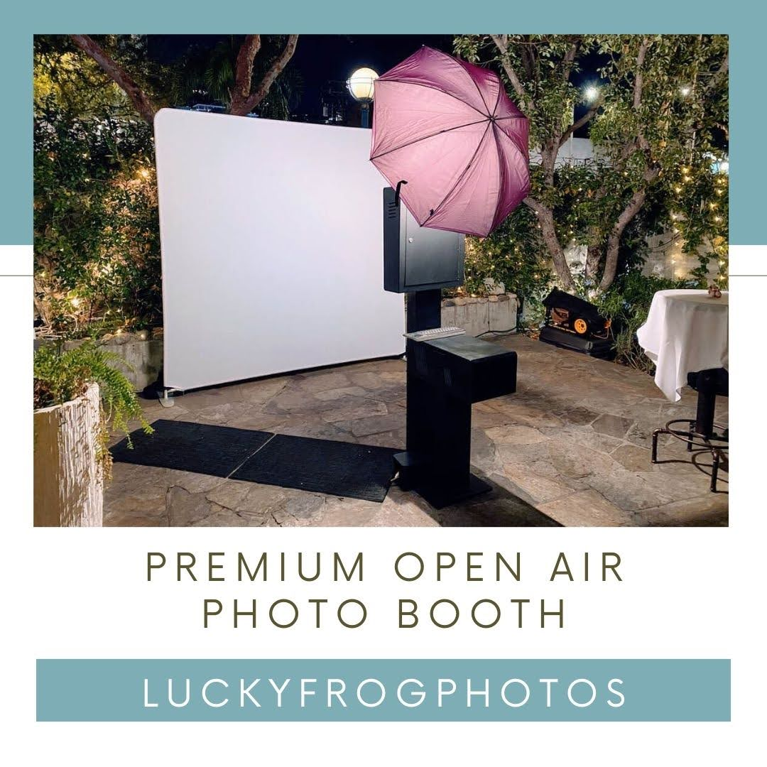

Slide 8
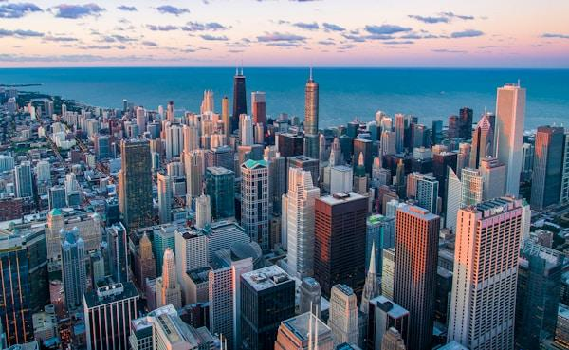

Slide 9
Links
List of recommended resources
Notes:
photo booth rental in Culver City

Slide 10
Please visit :
target url
folder top
rss feed
folder articles
folder photos
folder pdfs
folder slides
photo
photo
spreadsheet
spreadsheet key
spreadsheet pubhtml
spreadsheet pub
spreadsheet view
form
drawing
image
image link
document
document pub
document view
presentation
presentation pub
presentation view
presentation html

Slide 11
Videos
YouTube videos we recommend watching!
Notes:
photo booth rental in Culver City

Slide 12
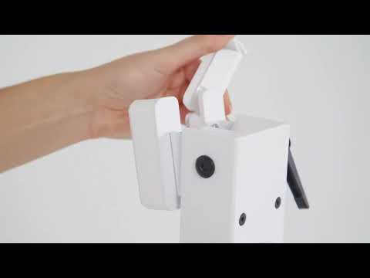
https://www.luckyfrogphotos.com/culvercityphotobooth.html

Slide 13
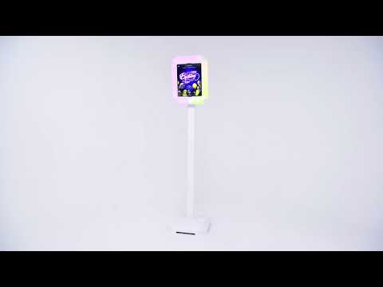
https://www.luckyfrogphotos.com/culvercityphotobooth.html

Slide 14
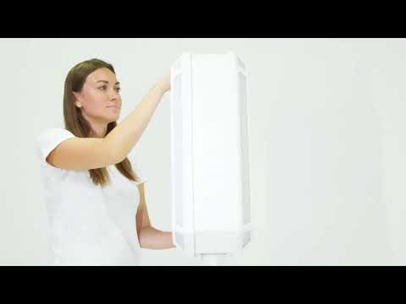
https://www.luckyfrogphotos.com/culvercityphotobooth.html

Slide 15
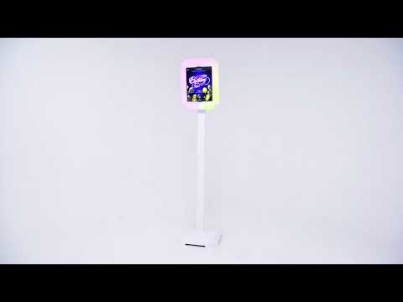
https://www.luckyfrogphotos.com/culvercityphotobooth.html

Slide 16
https://www.luckyfrogphotos.com/culvercityphotobooth.html
Notes:
https://www.luckyfrogphotos.com/culvercityphotobooth.html
https://drive.google.com/drive/folders/1I6R9-rYT0dGtkdSSy_KoznKsqANOl7vo?usp=sharing
https://news.google.com/rss/search?q=videobooth
https://drive.google.com/drive/folders/1fz3MRTHqumYW9T_yhq1sJNXEaAI-SV1p?usp=sharing
https://drive.google.com/drive/folders/19E3a0DxL9zoXjvwMzIuZp1t-Y7DpGITl?usp=sharing
https://drive.google.com/drive/folders/1YdJqhK5hH37CRHupORSbvk9wfbtfe5a3?usp=sharing
https://drive.google.com/drive/folders/1yq_rvIpjf9fM7tolY6arXn-zbxeYDJVS?usp=sharing
https://drive.google.com/file/d/1t33hvFbsi4sSFSNdR8g74m5ACVKQUi0g/view?usp=sharing
https://drive.google.com/file/d/1zOl_0XNcTy6PryQuzm9JOEunbIaWwi8Z/view?usp=sharing
https://docs.google.com/spreadsheets/d/1OVT5yraxS5wjWLc6k7sw89mEC_b1-0gBgUpnB3NT2IA/edit?usp=sharing
https://docs.google.com/spreadsheet/pub?key=1OVT5yraxS5wjWLc6k7sw89mEC_b1-0gBgUpnB3NT2IA
https://docs.google.com/spreadsheets/d/1OVT5yraxS5wjWLc6k7sw89mEC_b1-0gBgUpnB3NT2IA/pubhtml
https://docs.google.com/spreadsheets/d/1OVT5yraxS5wjWLc6k7sw89mEC_b1-0gBgUpnB3NT2IA/pub
https://docs.google.com/spreadsheets/d/1OVT5yraxS5wjWLc6k7sw89mEC_b1-0gBgUpnB3NT2IA/view
https://docs.google.com/forms/d/16B2HxuSeFbeXYinSv_AilgUvJf4qxj78DgP7lfIc6p0/edit?usp=sharing
https://docs.google.com/drawings/d/1iFVgJRf2VdbzqoWwdN1jPBoTL09CZXeGnhHoTIs_qgw/edit?usp=sharing
https://drive.google.com/file/d/1Ub_baxN1yIKa7z6PHbWKiQ5Hv3QmkYdb/view?usp=drivesdk
https://sites.google.com/view/culvercityphotoboothrentals/home
https://docs.google.com/document/d/1kL-FctTx5XoCFD61RSPQO7RJ9h6wzXbRa-pCid0ppDY/edit?usp=sharing
https://docs.google.com/document/d/1kL-FctTx5XoCFD61RSPQO7RJ9h6wzXbRa-pCid0ppDY/pub
https://docs.google.com/document/d/1kL-FctTx5XoCFD61RSPQO7RJ9h6wzXbRa-pCid0ppDY/view
https://docs.google.com/presentation/d/1Y9vC6BNYbxHj5DnqzJHdpFd3jgOH6z_a3h9cJ0d7ILs/edit?usp=sharing
https://docs.google.com/presentation/d/1Y9vC6BNYbxHj5DnqzJHdpFd3jgOH6z_a3h9cJ0d7ILs/pub?start=true&loop=true&delayms=3000
https://docs.google.com/presentation/d/1Y9vC6BNYbxHj5DnqzJHdpFd3jgOH6z_a3h9cJ0d7ILs/view
https://docs.google.com/presentation/d/1Y9vC6BNYbxHj5DnqzJHdpFd3jgOH6z_a3h9cJ0d7ILs/htmlpresent

Slide 17
photo booth rental in Culver City
https://www.luckyfrogphotos.com/culvercityphotobooth.html
Notes:
photo booth rental in Culver City

